Slide 1
COPD
Dr Yogini Raste
Consultant Chest Physician
Croydon University Hospital

Slide 2
What is COPD?
COPD stands for chronic obstructive pulmonary disease – a term that covers conditions including emphysema and chronic bronchitis
Chronic bronchitis – inflammation and narrowing of the airways
Emphysema – destruction of the alveoli causing reduction in ability of lungs to perform gas exchange; air also gets stuck, ‘gas trapping’
Both these processes make it more difficult to move air in and out of the lungs
Symptoms: breathlessness, wheeze, cough, sputum/mucus; can get recurrent infections

Slide 3
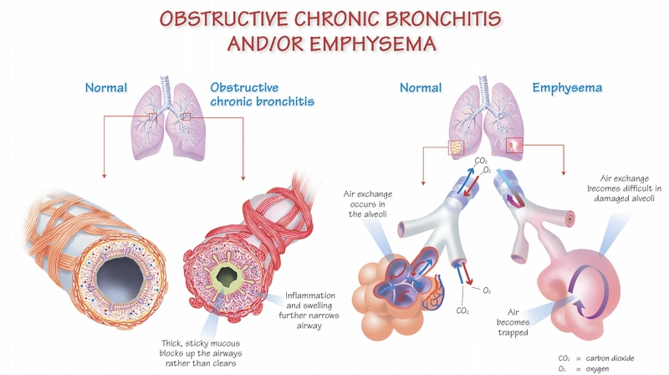

Slide 4
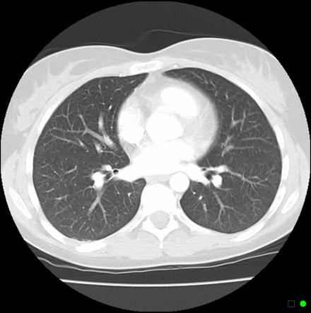
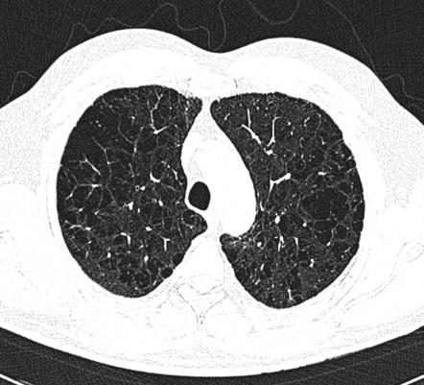
CT

Slide 5
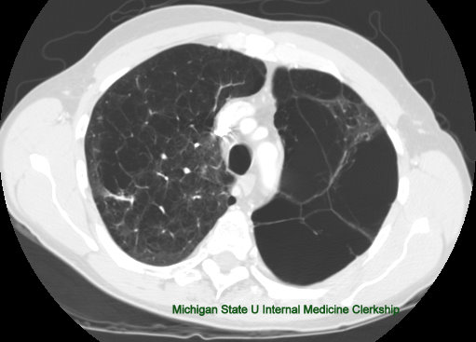
CT

Slide 6
What is COPD?
COPD is predominantly caused by smoking
In the developing world, it is also associated with exposure to smoke from open fires
Passive smoking can also cause respiratory symptoms, especially in children
Smoking cannabis with tobacco has a superadded effect on the lungs causing emphysema
People who have an enzyme deficiency (alpha-1-antitrypsin) are also more at risk if they smoke

Slide 7
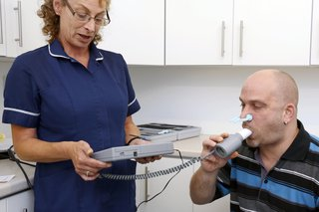
Diagnosis
Symptoms
Smoking history
Spirometry – breathing test measuring the flow of air out of the lungs

Slide 8
COPD as a multisystem disease
Respiratory
Skeletal muscle dysfunction
Weight loss
Cardiovascular disease
Osteoporosis
Depression

Slide 9
Physical activity in COPD
Importance in keeping people out of hospital, reducing the risk of them getting readmitted
Reduced physical activity is the strongest predictor of mortality in COPD

Slide 10
COPD – the ‘Missing Millions’
In the UK approx. 900,000 formally diagnosed with COPD, but an estimated 2 million remain undiagnosed
Importance of early diagnosis – help people with quitting smoking, starting medications, treating infections early and getting active

